Slide 1
Classical Encryption
Sarjoun Radiyeh
Antoine Abou Faycal
Wael Dgheim
Adel El Kadi

Slide 2





OUTLINE
Introduction
Project Description
Interface Discussion
Testing and Results
Group Work

Slide 3
Introduction
Focus: This project aims to explore and showcase the functionality of historic ciphers within a modern web-based application.
Key Points:
Highlighting Affine, Vigenère, Hill, and other classic encryption methods.
Showcasing user-friendly interfaces for encryption/decryption operations.
User Experience: Transforming encryption algorithms into an intuitive cloud-hosted experience.

Slide 4
Project Description
Main Features: Covered encryption and decryption for Affine, Vigenere, Monoalphabetic, Playfair, and Hill ciphers as well as the Extended Euclidean Algorithm.
Additional Features: Added two functionalities for cracking Affine Cipher.
Framework Choice: Utilized Django, a high-level Python web framework, for its rapid development and practical design capabilities.
Cloud Platform: Opted for Azure, known for scalability and consistency, to host the project.
Work Division:
Frontend: Implemented using HTML and CSS for website design.
Backend: Developed using Python to implement encryption techniques

Slide 5
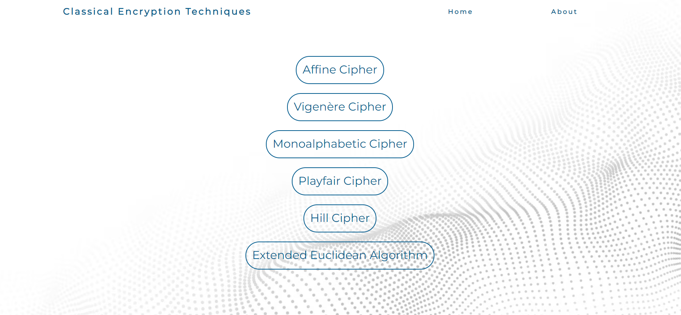
Interface Discussion
Link to Classical Techniques Website

Slide 6
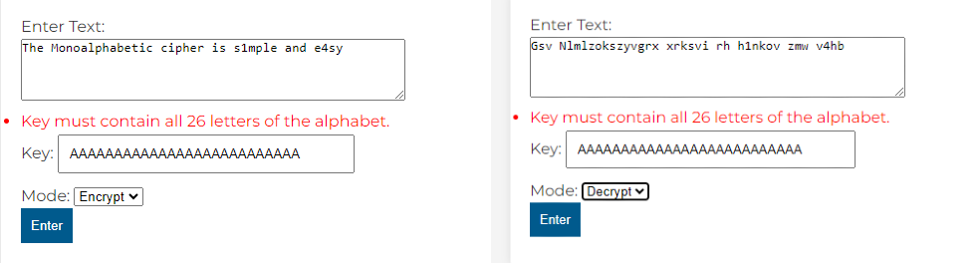
Testing and Results
This section rigorously evaluates our code's performance through diverse test cases. The subsequent presentation highlights outcomes, offering a comprehensive overview of the code's functionality and robustness across various scenarios
We showcased how each technique worked on our website in addition to also showcasing cases when the website would not run for example when the user would input invalid characters an error message would pop up .
Encryption/Decryption of the monoalphabetic cipher

Slide 7
Group Work
As a group we divided work amongst ourselves assigning each member an equal amount of work for the website:
Backend: Sarjoun and Wael
Frontend: Adel and Antoine
For the report each member was assigned an encryption technique to work on:
Affine cipher: Sarjoun
Monoalphabetic and Vigenere cipher: Adel
Playfair cipher: Wael
Hill cipher and Extended Euclid: Antoine
As a team we would meet up once a week to check on our progression either online or in person

Slide 8
Any Questions?

